Slide 1
Using Matlab for Accelerator Experimentation and Control
Greg Portmann
December 1, 2004
Notes:
Online Control – Application and experiment scripting
Simulation

Slide 2
Why Matlab
Matrix programming language
Extensive built-in math libraries
Active workspace for experimentation and algorithms development
Graphics
Adequate GUI capabilities

Slide 3
Automating Physics Experiments
(without becoming a software engineer)
Goal
Develop an easy scripting method to experiment with accelerators (ideally accelerator independent)
  Remove the control system details from the physicist (like channel names and how to connect to the computer control system)
  Make working on an accelerator more like simulation codes.
  Easy access to important data (max/min, offsets, gains, rolls, …)
  Develop a library of common tasks (orbit correction, chromaticity measurements, etc.)
Integrate simulation and online control
Integrate data taking and data analysis tools
Develop high level control software to automate the setup and control of a storage ring.

Slide 4
Matlab Toolbox Suite for
Accelerator Physics
AT – Accelerator Toolbox (Simulation)
LOCO – Linear Optics from Closed Orbits (Calibration)
MiddleLayer – 1. Link between applications and control system or simulator. 2. Functions to access accelerator data. 3. Provide a physics function library.
MCA, LabCA, UCode – Matlab to EPICS links

Slide 5
Data Flow Diagram
High Level Matlab Applications
(Matlab)
MiddleLayer
(Matlab)
MCA
AT Simulator
(Matlab)
EPICS - Channel Access
AT Server
(Matlab)

Slide 6
Basic Calls
Naming Convention
Family = Group descriptor (text string)
Field = Subgroup descriptor (text string)
DeviceList = [Sector Element-in-Sector]
Basic Functions
getpv(Family, Field, DeviceList);
setpv(Family, Field, Value, DeviceList);
steppv(Family, Field, Value, DeviceList);

Slide 7
Families (>> showfamily)
Bend magnets – BEND
Quadrupoles – QF, QD, QFA, QDA
Sextupoles – SF, SD
Skew quadrupoles - SQSF, SQSD
Correctors – HCM, VCM, VCBSC
Beam position monitors – BPMx and BPMy
Chicane magnets – HCMCHICANE, VCMCHICANE
Insertion devices – ID, EPU
Other - RF, DCCT, TUNE, IonGauge, IonPump, GeV, BSC
Fields
Setpoint, Monitor, RampRate, TimeConstant, Sum, RunFlag,
Trim, FF, DAC, On, Reset, Ready, Voltage, Power,
Velocity, UserGap, HallProbe, Limit, etc…

Slide 8
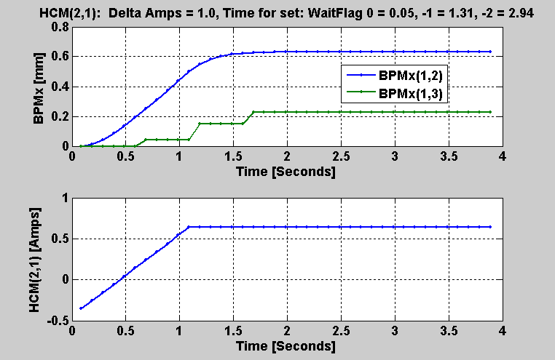
Setting Magnets and Waiting for BPMs
Default WaitFlag = -2 (ALS) and 0 (Spear)

Slide 9
Function Library
There are hundreds of functions for accelerator control (see MiddleLayerSoftware.doc or look in the directory /home/als/physbase/matlab2004/acceleratorcontrol)
measchro – measure the chromaticity
setchro – sets the storage ring chromaticity
measdisp – measure the dispersion function
settune – sets the storage ring tune
physcis2hw – converts between physics and hardware units
measbpmresp – measure a BPM response matrix
measlifetime – computes the beam lifetime
minpv/maxpv – min/max value for family/field
setorbit – general purpose global orbit correction function
setorbitbump – general purpose local bump function
srcycle – standardizes the storage ring magnets
scantune – scan in tune space and record the lifetime
scanaperture – scans the electron beam in the straight sections and monitors lifetime
quadcenter, quadplot – finds the quadrupole center
finddispquad – finds the setpoint that minimizes the dispersion in the straight sections.
rmdisp – adjusts the RF frequency to remove the dispersion component of the orbit by fitting the orbit to the dispersion orbit
etc

Slide 10
Data Management
Beam Position Monitors
  Channel names, gains, roll, crunch, offsets, golden, standard deviations
Magnets
  Channel names, gains, offsets, roll, setpoint-monitor tolerance, amp-to-simulator conversions, hysteresis loops, max/min setpoint
Response matrices (Orbit, Tune, Chromaticity)
Lattices (Save and restore)
Measurement archiving
  Dispersion, tunes, chromaticity, quadrupole centers, etc.

Slide 11
MiddleLayer Applications
Magnet standardization
Magnet lattice save / restore / configuration control
Orbit (local/global), tune, chromaticity measurements and correction
Dispersion measurement
Energy Ramping
Slow orbit feedback
Insertion device compensation
LOCO
Quadrupole centering
Display (plotfamily) / Diagnostics
Online accelerator model (AT)

Slide 12
Online Model (AT)
What’s in the Middle Layer Part of the Model
BPM – gain, roll, crunch
Corrector magnets – gain, roll
Lattice magnets – gain, hysteresis (only upper branch at the moment), correction offset.
What’s in the AT Part of the Model
Everything else!
Present State of the Model
Needs a little more fine tuning (LOCO data, hysteresis)

Slide 13
MiddleLayer Data Flow Diagram
Accelerator Hardware
Data flow for getpv, setpv, steppv
AT Model
getpvonline
setpvonline
getpvmodel
setpvmodel
BPM and Corrector
Coordinate Change
hw2physics
physics2hw
Hardware Units
(Usual Command Window Location)
Physics Units
(Opt. Command Window Location)
raw2real
real2raw
Calibrated Hardware Units
RealData = Gain*(RawData - Offset)
  BPM
  Gain (LOCO)
  Offset (BBA)
  Correctors
  Gain (LOCO)
  Lattice Magnets
  Gain (LOCO)
BPM
Gain (Units scaling)
Correctors
(amp2k, k2amp)
Gain (amps to rad.)
Energy Scaling
Lattice Magnets
(amp2k, k2amp)
Gain (amp to K)
Energy Scaling
Hysteresis
BPM
Roll, Crunch
Correctors
Roll
Correction offset
Lattice Magnets
Correction offset
All other known errors are already in the AT model.

Slide 14
How to Use the Model or Online Accelerator
Make the model the default
>> switch2sim
Make the accelerator the default
>> switch2online
Mixed mode – use keyword overrides
'Simulator' – Run the same code as online just use the AT model for input/output.
'Model' – Some code uses the AT model more directly (like measbpmresp or measchro)
Note: ‘Model’ and ‘Simulator’ are often the same.

Slide 15
How to Switch Between
Hardware and Physics Units
Make the hardware units the default
>> switch2hw
Make the physics units the default
>> switch2physics
Mixed mode – use keyword overrides
'Hardware' – Force hardware units for this function.
'Physics' – Force physics units for this function.
Example:
>> Amp = getpv('QF', 'Hardware');
>> K = getpv('QF', 'Physics');

Slide 16
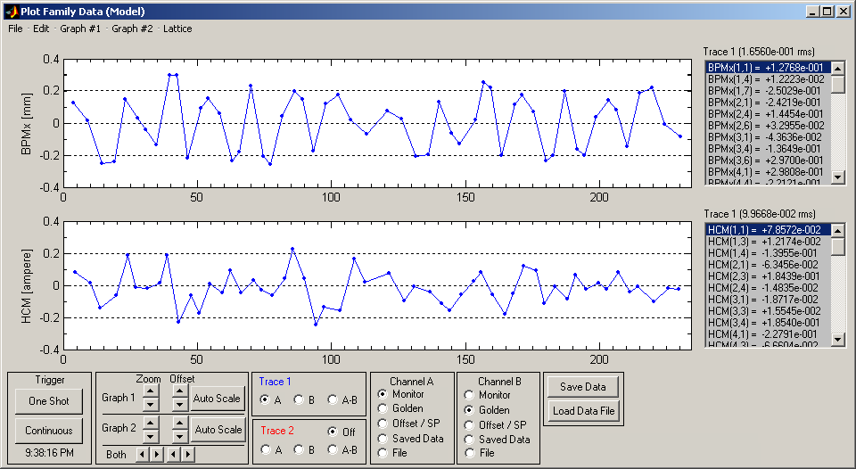
plotfamily application

Slide 17
Scripting Example: Orbit Correction
% Create an Orbit Error
hcm = randn(94,1); vcm = randn(70,1);
setsp('HCM', hcm); setsp('VCM', vcm);
% Get the Vertical response matrix from the model
R = measbpmresp('Struct','Model');
Ry = R(2,2).Data;
% Computes the SVD of the response matrix
Ivec = 1:54;
[U, S, V] = svd(Ry);
% Gets all vertical orbit
Y = gety;
% Find the corrector changes
DeltaAmps = V(:,Ivec) * ((Ry * V(:,Ivec)) \ -Y);
% Changes the corrector strengths
stepsp('VCM', DeltaAmps);

Slide 18
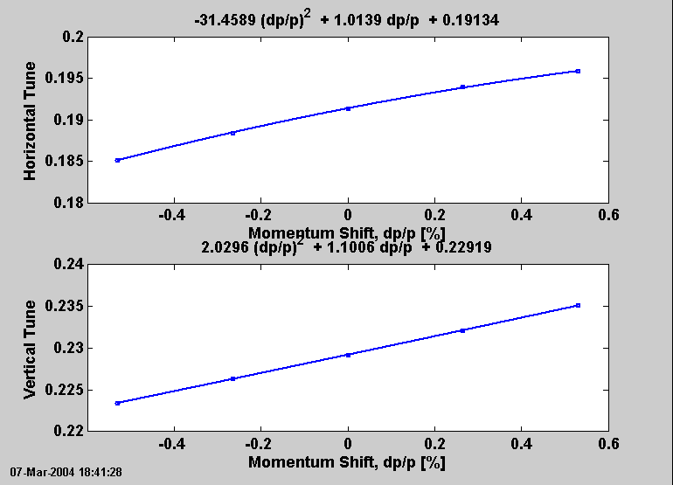
Chromaticity Measurement

Slide 19
Conversion Plan
Physics Shifts (Ready)
  Calibrated model needs some fine tuning
  (Warning: this can turn into a lifelong endeavor)
Machine Setup
  Orbit, Tune, Chromaticity (ready)
  ID feed forward table tables (needs work)
  Read/display archived data (ready)
Machine Operations
  Convert srcontrol (probably less than a week of effort + testing)
  We need to choose/find a stable platform.

Slide 20
Conclusion
Relatively easy to use. Most people start writing useful scripts in a few hours.
MiddleLayer + LOCO + AT + MCA/LabCA cover many of the high level software concerns for storage rings.
It’s a good scripting language or it can be the entire high level setup and control software for a storage ring.
AT model is good for debugging software without using accelerator time.
ALS, Spear, BNL, and CLS are active MiddleLayer users. NSRRC, PLS, DESY, DIAMOND, Soleil, ALBA, and Australia are experimenting with it.
The semi-machine independence software may foster better collaborations between the laboratories.

